Slide 1
Classify space rocks by using Python and artificial intelligence
Abhigya Verma Microsoft Learn Student Ambassador Alpha

Slide 2
Module 3: Analyze images of rocks by using artificial intelligence Identify data to add to an artificial intelligence model that classifies space rocks in random photos.
Abhigya Verma Microsoft Learn Student Ambassador Alpha
Notes:
In the first two modules, you learned about artificial intelligence (AI) and how the technology can be used to enhance a project. Now you can start to create your own program that uses AI.
Installing Python AI libraries is a great first step in creating a rock classification program. The libraries give you a base model that you can train to complete the task at hand.
In this Microsoft Learn module, we'll use Visual Studio Code, Python, and Jupyter Notebook. You'll review code to clean rock images to prepare data for the program. Then we'll look at the code to create and train the AI model.

Slide 3
Learning objectives
In this module, you will:
Import AI libraries
Download and import data to use with an AI program
Learn how to clean and separate data
Discover how computers read photos as images by using binary format
Use code to read an image and assign the correct rock type

Slide 4
Prerequisites
Ability to write and run introductory Python programs
Visual Studio Code, with the Python extension installed
Artificial intelligence libraries installed

Slide 5
Exercise - Import Python libraries into Jupyter Notebook
Notes:
Now that you have the libraries downloaded, you can begin to import them into a Jupyter Notebook file.

Slide 6
Add import statements for the libraries
Notes:
Follow these steps to add code to import the AI libraries. Insert each new section of code into an empty cell in your Jupyter Notebook file. Select the green arrow at the top of the cell to run the new code.

Slide 7
How to clean and separate data for AI projects
Notes:
The next step is to import the data of existing rock images that we'll use to teach our computer to recognize different types of rocks.
Before we import images, we need to review two critical steps in the AI process: cleaning and separating data. It's important to complete these steps to ensure the computer can accurately classify the rock images.

Slide 8
Clean data
Notes:
To clean our data, we need to make sure it's complete and uniform. In our rock example, many image files have different sizes. For a clean set, we need to resize every image file so they're all same size. We might have to fill in cells where data is missing, and delete rows with incorrect data.

Slide 9
Separate data
Notes:
To program AI, first we give the computer lots of data and tell it what the data represents. This process is called training. After we train the computer, we test the computer to see if it can classify new data we input.
NASA provided a large amount of data about different rock types. We need to tell the computer which data to use for training and which to use for testing. To do the separation, we randomly distribute the data into these two groups. The ratio of how much data goes into each group can vary. In our example, we'll train with 80% of the data and test with 20% of the data.

Slide 10
Exercise - Import and clean data from photos
Notes:
Now that we know about cleaning and separating the data, we can apply these principles to our rock classification project.

Slide 11
Prepare the data
Step 1. Get the data
Step 2. Clean the data
Step 3. Separate the data
Step 4. Load random datasets
Notes:
We need to create two datasets from the NASA photos for our classification project. One dataset is for training and the other is for testing. The images need to be cleaned and separated before we load them into datasets for processing. The data should be processed in a random manner, and not in the exact order it was provided by NASA.
We'll use code to accomplish these four steps to prepare our data:
Step 1. Get the data: Tell the computer where to get the image data.
Step 2. Clean the data: Crop the images to the same size.
Step 3. Separate the data: Separate the data by shuffling and random selection.
Step 4. Load random datasets: Prepare random samples for training and testing datasets. Step 1. Get the data
We need to let the computer know where it can find the data. In our example, we use the rock images provided by NASA. We already downloaded and stored the photos into the Data folder that's in the same project folder as our Jupyter Notebook file. We'll tell the computer to load the image data from the Data folder.
Step 2. Clean the data
The rock photos from NASA come in different sizes: small, medium, and large. We'll crop the images so they're the same size (224 × 224 pixels). We resize the images because computers expect images to be the same size. If images vary in size, they're not as easy for the computer to process. We use the torchvision transforms.Compose class to resize the images to our preferred dimensions and store the modified images in local variables.
Step 3. Separate the data
20% of the cleaned images are for training and the other 80% is for testing. The computer should pick images by random, and not use them in the exact order they were provided by NASA. We use two techniques to do the separation: shuffling and random selection.
We create an index list that corresponds to the number of images. We use this list to find the index of the image that represents 20% of the data. We store this location in a variable named split. We shuffle the index list, and by using the image location at split, we create our two datasets for training and testing. The resulting sets consist of images that are cleaned and are selected at random.
We use the load_split_train_test function to get the shuffled data for training and testing.
Step 4. Load random datasets
To load random images from our two datasets, we call the SubsetRandomSampler function from the torch.utils.data.sampler library. We'll load random samples of 16 images each.

Slide 12
Add code to clean and separate the data
Notes:
We're ready to add the code to clean and separate the data.
Go to this Azure Blob storage and download the Data.zip folder.
Unzip the Data folder and put it in the same folder as your Jupyter Notebook file.
In Visual Studio Code, return to your Jupyter Notebook file.
Add the following code in a new cell to import the Python Imaging Library (PIL). We'll use this library to visualize the images. After you add the new code, run the cell.
After you run the cell, you should see the two rock classification types in the output: ['Basalt', 'Highland'].
The space rock data is now imported, cleaned, and separated. We're ready to train our model with 80% of the data and run tests with the remaining 20%.

Slide 13
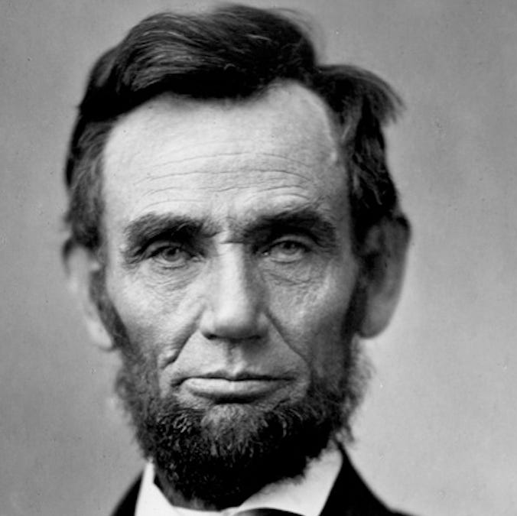
How a computer reads a photo as an image file
Notes:
Now that we have our data cleaned and separated, you might wonder how the computer reads these images.
Hint: Computers can't read images the same way humans do.
If you know something about developing for computers, you probably know computers read data in binary format.

Slide 14
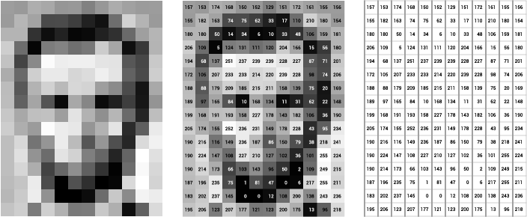
Notes:
The data is represented as a long series of ones and zeroes like 101011001110001010111, and so on.
So, how can a computer read a complex image as only a series of ones and zeroes?
If you zoom in on the data in an image, you'll discover the picture in the photo is represented in the image file as pixels. Each pixel is a specific color that has a unique code. After the computer converts a photo into an image with these codes, it can read and decipher the binary pixel data.
Here's an example that shows how a computer transforms a photo into a series of numbers in an image file:

Slide 15
Transform and display the images
Notes:
In this section, we'll add code to match each rock image with a rock type, based on the image folder. We call the transforms.Compose class again to transform each image into pixels and resize it to our preferred dimensions.
We select a set of images by random in a manner similar to how we used the load_split_train_test and SubsetRandomSampler functions in the last exercise. The code iterates over the shuffled images in the testing dataset.
The last section of code displays the images that are loaded into the program. We use functions from the PIL library to manipulate the images, and the plt.show command to print them.

Slide 16
Add code to transform and select random images
Notes:
In this section, we'll add code to match each rock image with a rock type, based on the image folder. We call the transforms.Compose class again to transform each image into pixels and resize it to our preferred dimensions.
We select a set of images by random in a manner similar to how we used the load_split_train_test and SubsetRandomSampler functions in the last exercise. The code iterates over the shuffled images in the testing dataset.
The last section of code displays the images that are loaded into the program. We use functions from the PIL library to manipulate the images, and the plt.show command to print them.

Slide 17
Add code to show randomly selected images
Notes:
After you run this new code, you should see five cleaned images in the output. The code is set to show five images, but you can change the number.

Slide 18
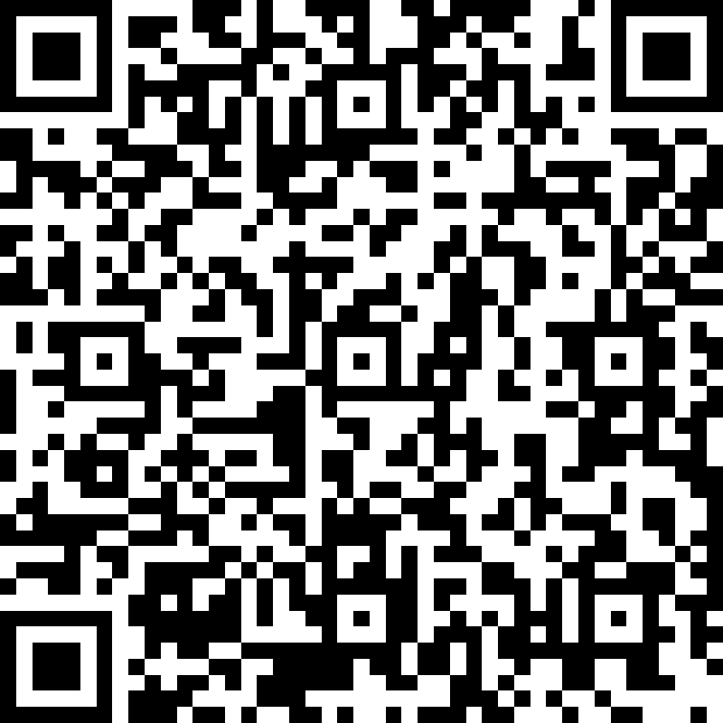
QUIZ TIME!!!
https://forms.office.com/r/h7e9TfFdD1
Notes:
In this lesson, you learned more about space rocks and AI.
You studied the differences between basalt and highland rock, and learned how distinguishing characteristics, or features, help to form classifications.
You considered the steps humans follow to examine and classify objects, and then reviewed how we can teach machines to classify objects by following a similar process.
You learned about different Python libraries for AI, including Matplotlib, NumPy, and PyTorch.
You used Anaconda to download the Python libraries to your computer and installed them in preparation for building an AI model.

Slide 19
THANK YOU SO MUCH!!!
Notes:
In this lesson, you learned how to analyze images of rocks by using artificial intelligence.
You imported AI libraries to use with a Jupyter Notebook file.
You discovered why it's important to prepare data for AI projects before you test the model.
You learned how to get a set of data ready to train an AI model. You added code to clean and separate the data into training and testing groups.
You studied how computers read photos as images by converting into pixels with color codes in binary format.
You added code to read an image and assign the correct rock type.
You learned how to display an image with commands from the PIL library.

